Slide 1
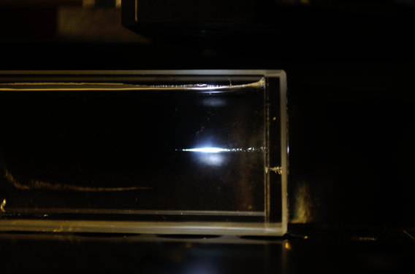
Long-Term Remote Water Quality Sensor System
Dustin L. McIntyre, PhD, PE
Team Lead USDOE NETL
For more information, contact techtransfer@netl.doe.gov
the ENERGY lab

Slide 2
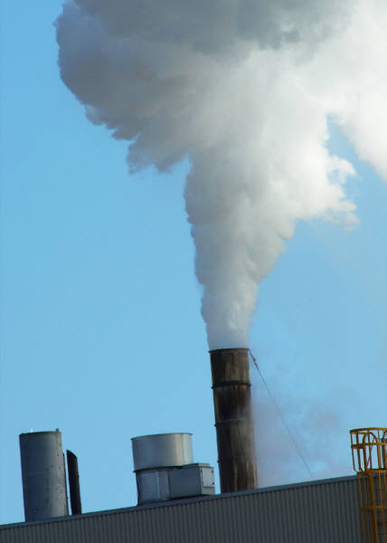


The Need and Market
Sensors are increasingly needed to continuously measure:
Ground water quality
  Pollutants in fresh and salt water systems
Air quality, both indoors and outdoors
Gas composition
  Natural gas, volcanic gas, landfill gas, shale gas, flue gas
Soil composition and changes
  These measurements are important to oil and gas exploration companies, landowners, regulatory agencies, and municipalities, and any organization monitoring emissions.
2

Slide 3
The Need and Market (cont)
Subsurface activities
  Carbon Sequestration activities
  Hydrofracturing activities
  Mining
  Waste disposal
NETL Technology would offer
  Continuous long term ground water sensing across a wide area
  Air sensing
  Measurement of changes in solid materials

Slide 4
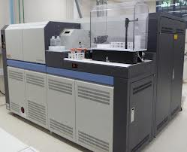
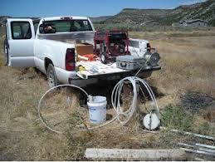
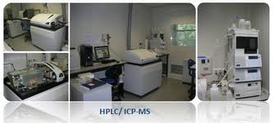
The Problem
  Current sampling and analysis is labor intensive and significantly changes the sample by cooling and depressurizing.
  Current analysis technology is not amenable for harsh environments.
3

Slide 5
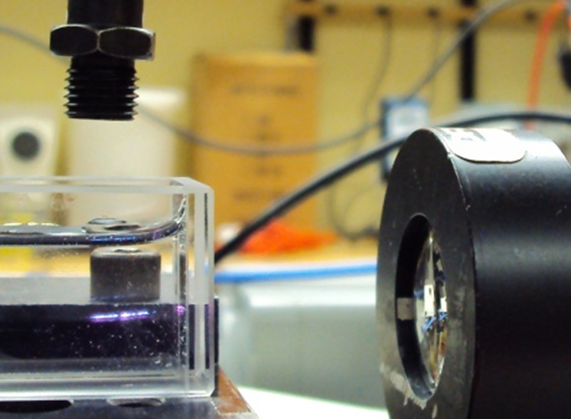
The Solution
  Combination of LIBS and RAMAN to measure subsurface gases, liquids, and solids at subsurface conditions, with:
  Continuous monitoring of an extreme environment (10 Hz per sensor)
  No sample collection
  No sample preparation
  Easy to use
  Low cost (compared to competitors)
  High data quality
  The ability to see changes in down hole fluid chemistry before and after injection and/or fracturing
  Distributed Multi-sensor network
  Immediate data turnaround
  Data many times a second
4

Slide 6
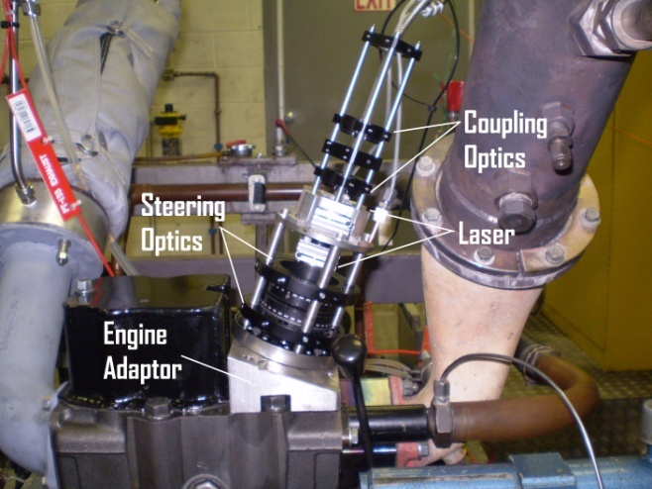
The Technology
Laser Induced Breakdown Spectroscopy (LIBS)
RAMAN Molecular Sensing
Identification and concentration measurements can be made on solids, liquids, and gases at down hole pressure and temperature conditions
Technology was developed at NETL as part of the DOE Sensors and Carbon Storage program
Development Stage:
  Proof of concept experimentation completed
  Prototype and system design and development underway
Two U.S. Nonprovisional Patent Applications have been filed
US Patent 8,786,840 Granted
5

Slide 7
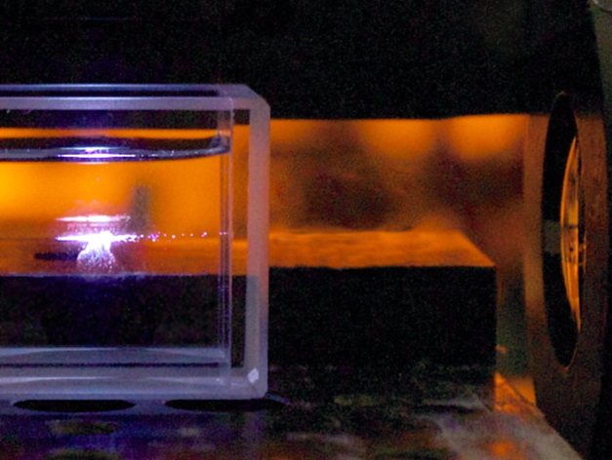
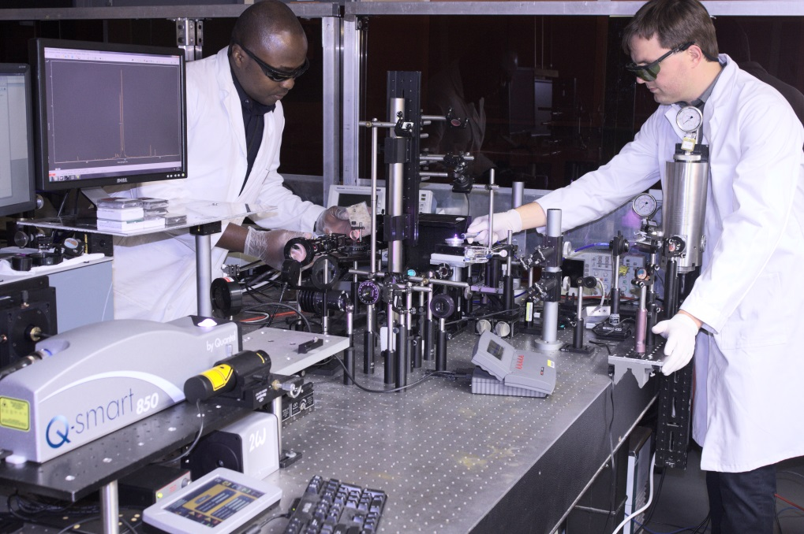
The Team
Dr. Dustin McIntyre, Laser/optical design and sensing (12 yrs)
Dr. Steven Woodruff, Laser/optical design and sensing (30+yrs)
Dr. Jinesh Jain, Geochemistry and optical sensing (30+yrs)
Dr. Christian Goueguel, Physics and optical sensing (Post Doc)
Dr. Cantwell Carson, Materials engineering and prototype development (Post Doc)
6

Slide 8
Competition
 | Lab Based | Phase | Equip. Cost | Turn-around | Complex Prep | Output Info
GC-MS | X | Gas | >$100k | Days |  | Molecular
ICP-MS | X | Liquid | >$100k | Days | X | Atomic
HPLC | X | Liquid | >$100k | Days | X | Molecular
CRDS | X | Gas | >$100k | Hours |  | Molecular
Portable Raman |  | Solid | ~$20k | Seconds |  | Molecular
NETL LIBS/RAMAN * |  | Solid, Gas, Liquid | ~$35k | Seconds |  | Atomic and Molecular
* Assuming 8 independent sensors connected to base station
7

Slide 9
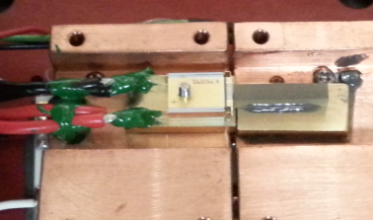
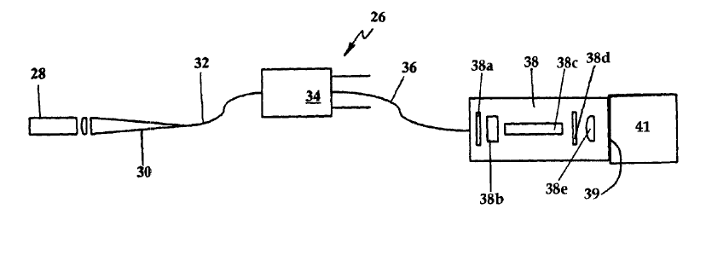
Costs
Current method of data collection
  Single Point individual analysis ($500) takes up to a week
NETL System (with appropriate volume)
  Multiple locations, multiple measurements per second continuously
  Laser sensors (<$100 each)
  Spectrometer, computer, distributor (~$25k)

Slide 10
The Technology Summary
Summary
  Down hole contaminant monitoring
    Atomic identification and concentration measurements can be made on solids, in liquids and gases at down hole P/T conditions
  Market
    Regulators, Exploration Companies, Municipalities, Land owners
  Development Stage
    Laboratory Investigations
    Prototype design phase
Funding
  Source of funding – DOE as part of the Sensors & Carbon Storage Program
Strength of the team
  Optical measurement and laser design experts Dr.s Woodruff and McIntyre USDOE
  Geochemistry Expert Dr. Jinesh Jain
  Physics and Materials Engineering Dr.s Goueguel and Carson

Slide 11
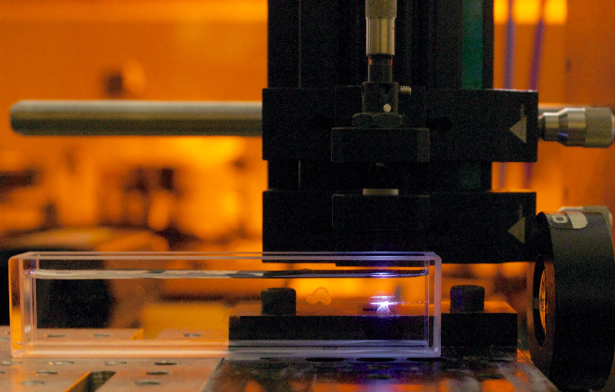
Partnership Opportunity
This technology is available for licensing and/or further collaborative research from the U.S. Department of Energy’s National Energy Technology Laboratory.
For more information, contact techtransfer@netl.doe.gov

